Slide 1
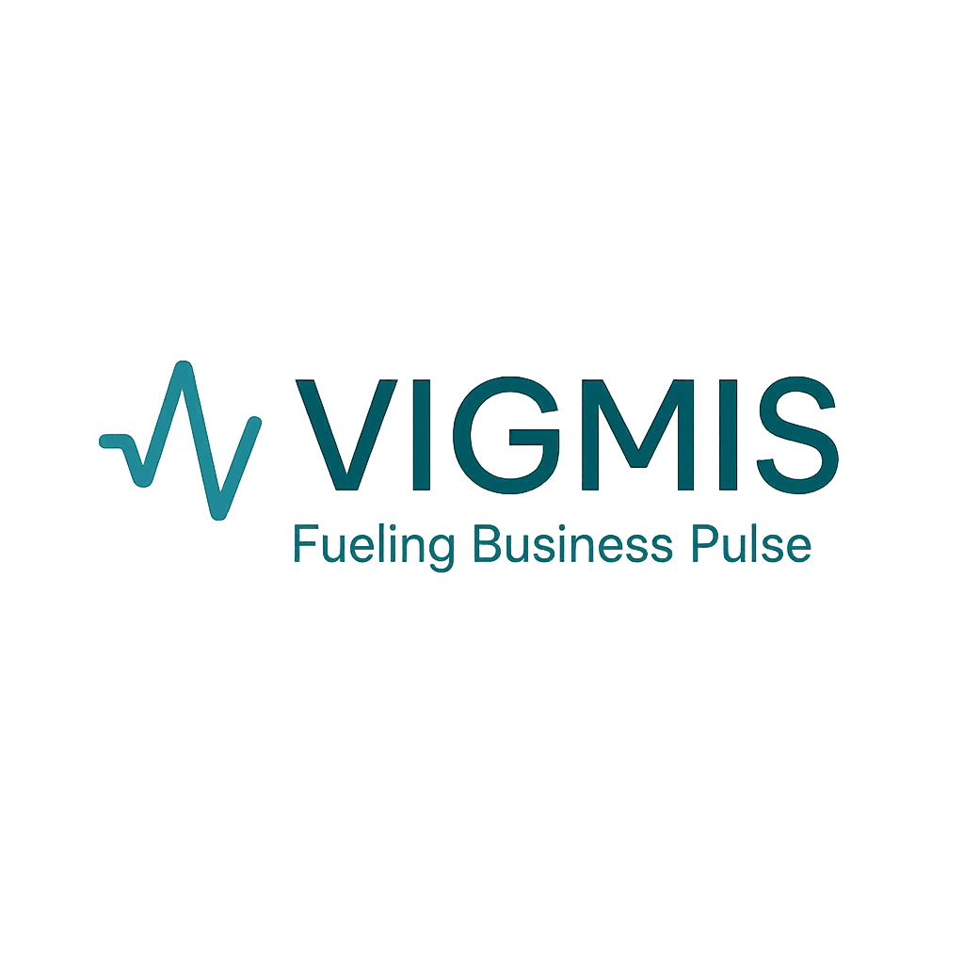
The next-generation AI-driven marketing platform.
Founders:
Liora Koren | Anna Natanzon | Gil Yehezkel
Tnufa, November 2025

Slide 2
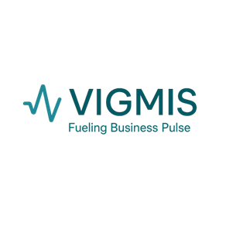
Today’s Digital Marketing Reality
Fragmented. Slow. Shallow. Expensive.
Businesses juggle multiple ad platforms (Google, Meta, TikTok, etc.)
Analyses are superficial and infrequent - once a week or less.
Systems are disconnected – sales data sits in CRM, ad data in separate tools
Campaigns rely on trial and error, wasting time and money.
Adjustments (changing audiences or creatives) are manual, slow, and costly.
Most systems react late - while the opportunity is already gone.
Today’s marketing is reactive. Vigmis turns it predictive and instant.

Slide 3
Vigmis
From reactive to predictive. From guesswork to intelligent automation
An AI-driven marketing platform that unifies research, creation, automation, and optimization.
Continuously learns what works — across audiences, geographies, and times.
Performs real-time adjustments: targeting, visuals, messages, and budgets.
Integrates with CRMs, ERPs, websites, and ad networks.
Leverages AI tools (OpenAI, Midjourney, Runway, Synthesia, Jasper) for:
Market analysis
Advertising optimization – crowds, geographies, timing, styles etc.
Businees fidback and Bizdev
Website improvements
Banner and video creation
Copywriting
Content creation
Landing page improvements
Etc..
Vigmis conducts the entire marketing orchestra - intelligently, automatically, and instantly.

Slide 4
Use Case: Michal (Online Cosmetics Store Owner)
Vigmis scans Michal’s website and analyzes her products, customers, and competitors.
Collects her marketing preferences, goals, and budget.
Recommends full campaign strategies per platform and audience.
Connects directly to ad platforms (Google, Meta, TikTok, etc.) to launch and manage campaigns automatically.
Generates ads, videos, and landing pages using integrated AI tools.
Runs A/B testing continuously across audiences, visuals, and messages.
Monitors performance in real time - turns off underperforming ads and reallocates budget to top performers.
Optimizes by region, demographic, and timing, creating dynamic personalized campaigns that evolve constantly.
Everything happens live, seamlessly, and intelligently - Vigmis doesn’t just analyze marketing, it runs it.

Slide 5
Market Opportunity
Global Digital Advertising: $488B (2024) → $1.16T (2030)
Marketing Automation Market: $6.6B → $15.5B, CAGR ~12%
AI in Marketing: growing >25% yearly
Businesses demand: transparency, automation, and measurable ROI.
Statista, Digital Advertising Worldwide Report, 2024
Fortune Business Insights, Marketing Automation Market Size, 2024–2030
MarketsandMarkets, AI in Marketing Market Forecast, 2024–2030

Slide 6
Competitive Landscape
Competitor | What They Offer | Missing vs. Vigmis
AdScale | Campaign automation & bid optimization | No creative generation, no real-time adaptation, disconnected from sales/CRM data
Madgicx | AI bid management, audience targeting | Limited creative tools, no website or landing page optimization, minimal learning feedback loop
HubSpot Ads | CRM-integrated marketing automation | Not multi-platform, lacks real-time creative optimization, weak AI-driven insights
Smartly.io | Paid social automation (mainly Meta, TikTok) | Limited to social ads, high cost, no cross-channel orchestration
Albert AI | Autonomous ad management | Focused only on optimization, no content or strategic campaign generation
Vigmis | Full-cycle AI marketing platform: research → content creation → launch → real-time optimization → predictive analytics | Combines automation, intelligence, creation, and continuous learning — one brain for the entire marketing ecosystem

Slide 7
Vigmis – redefining marketing
Continuous AI-driven learning and real-time optimization - the system constantly analyzes performance data and refines every element automatically.
Full-cycle campaign management - from market research and creative production to launch and live optimization.
Dynamic, multi-layered campaign orchestration - Vigmis runs multiple audience, time, and message variations simultaneously, adapting per platform, geography, and hour of day.
Individualized ad behavior - each audience segment sees different creatives, offers, and frequency, optimized in real time.
Instant performance shifts - underperforming ads are paused, budgets are redirected automatically to top-performing clusters.
Seamless integration with leading AI and data platforms (OpenAI, Google Cloud, Jasper, Synthesia, etc.) for intelligent content generation.
Transparency and insight - businesses gain visibility across the full marketing funnel, from ad to sale.
Empowers every business to market like an agency — only faster, smarter, and cheaper.

Slide 8
Business Model
Pay-per-click model: only $0.07 per click
No retainers, no setup fees – 100% transparency
Clients pay only for results, not for manpower or agency hours
Scalable SaaS model with predictable, recurring revenue

Slide 9
Redefining Marketing Economics
Traditional Agency Model (on top of ad account budget)
Monthly pre dig spend:
Ad production budget: $2,000
Agency retainer + fees: $1,500 (15% of ad account)
Total cost: ~$3,500
Performance:
~2,000 clicks/month
Effective CPC: ~$1.75 per click
Manual optimization, slow response, fragmented tools
Vigmis Model (on top of ad account budget)
Pay-per-click pricing:
$0.07 per click
2,000 clicks = $140 total
pay only $0.07 per click
Real-time AI optimization
Integrated with ad platforms and CRM
Continuous improvement and predictive targeting
Model | Monthly Cost | Clicks/month | Effective CPC | Optimization
Traditional Agency | ~$3,500 | ~2,000 | ~$1.75 | Manual, periodic, reactive
Vigmis (AI-based) | ~$140 | ~2,000 | $0.07 | Continuous, real-time

Slide 10
SWOT Analysis
Strengths | Weaknesses
• Real-time AI optimization | • Early-stage MVP
• Full marketing cycle automation | • Dependent on 3rd-party AI tools
• Multi-platform integration | • Limited brand awareness
• Low-cost, pay-per-click model | • Requires initial integrations
• Experienced founding team | • Small internal dev resources
Opportunities | Threats
• Fast-growing AI marketing market | • Strong competition (AdTech giants)
• Rising demand for automation | • Rapid tech and policy changes
• Affordable tools for SMEs | • Data privacy and API risks
• Expansion to predictive analytics | • Market education needed
• Global scalability | • Potential replication by competitors

Slide 11
The Team
Liora Koren – CEO & Co-Founder Strategic marketing leader | Growth & cross-market scaling | Co-founder of FoxyMedia
Anna Natanzon – COO & Co-Founder Operational & technology leader | Expert in digital marketing automation, ERP/CRM integration, CEO of Taurus
Gil Yizhakiel – Chairman & Co-Founder Creative strategist | Campaign innovation & product-market alignment | Co-founder of FoxyMedia

Slide 12
Tnufa Program Plan (12 Months)
Phase 1 (Months 1–6) – Development
System architecture and AI core engine design
UX/UI and dashboard development
API and CRM integrations
Internal testing and data model calibration Deliverable: Functional MVP ready for pilot testing
Phase 2 (Months 7–12) – Pilot & Optimization
Deployment with 10–20 pilot clients
Real-time learning and continuous improvement
Refinement of UX, automation, and predictive features
Preparation for scaling and fundraising Deliverable: Validated MVP ready for market launch and investment

Slide 13
Tnufa Deliverables & Next Development Phase
During Tnufa (12 Months – MVP Phase)
Goal: Build a functional, tested MVP demonstrating automation and real-time optimization.
Core campaign management engine across Google, Meta, TikTok
Real-time AI optimization (budget, targeting, creatives)
Website scan & analysis with improvement recommendations
Automated generation of basic ad creatives (text, banners, short videos)
Business Intelligence dashboard with real-time performance data
Smart control panel for advertisers (budgets, audiences, restrictions)
Initial pilot testing with 10-20 real clients
Deliverable: Functional MVP demonstrating measurable efficiency and automation in live campaigns
After Tnufa (Full-Scale Development Phase)
Goal: Expand capabilities into predictive, fully autonomous marketing platform.
Predictive analytics & ROI forecasting
Full automation for website optimization (UX/UI & content fixes)
Dynamic audience segmentation & localization
Advanced behavioral learning across platforms
AI-driven creative studio (video, copy, visuals)
Mobile management app
Open API for integrations with external AI & BI tools
Global scaling and investor readiness
Deliverable: Commercial-ready platform with predictive intelligence and global scalability

Slide 14
Use of proceeds
Category | Share | Purpose
Software Development | 60% | Core AI modules, integrations
AI APIs & Licenses | 10% | OpenAI, Midjourney, Synthesia
Cloud & Hosting | 5% | AWS / Google Cloud
UX & Design | 5% | Dashboards, interface
QA & Testing (Ad Spend) | 20% | Paid campaigns for real validation

Slide 15
KPIs & Expected Outcomes
20 pilot clients by program end.
30% average cost reduction vs agencies.
90% optimization accuracy.
Investor readiness by Q4 2026.
MVP ready for commercial deployment.

Slide 16
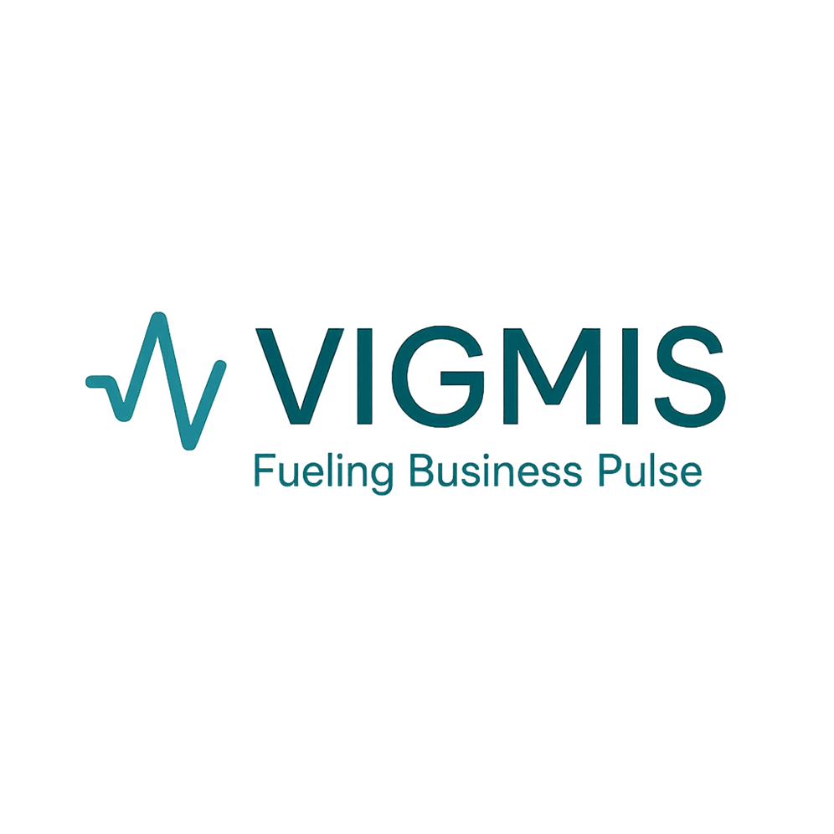
Empowering every business to market like the world’s biggest brands -intelligently, automatically, and affordably.

